Slide 1
Introduction to optimization algorithms to compress neural networks
Marcus Rüb
Marcus.rueb@hahn-schickard.de
https://www.linkedin.com/in/marcus-rüb-3b07071b2
Hahn-Schickard Villingen-Schwenningen
Notes:
Ob intelligenter Kühlschrank oder Sprachassistent, bereits heute sind in unserem Alltag viele Dinge mit künstlicher Intelligenz ausgestattet. Im Zeitalter des Internet of Things (IoT) und der Industrie 4.0 werden intelligente Systeme immer wichtiger.
Zur Ausführung von vielen neuronalen Netzen wird allerdings nicht immer die Rechenleistung von großen und teuren Rechner benötigt. Stattdessen kann hier auch die Rechenleistung eines eingebetteten Systems, wie die eines Mikrocontrollers, ausreichen.
Allerdings ist die Unterstützung von Plattformen zur Ausführung von neuronalen Netzen, nicht ohne weiteres gegeben ist.
Das Modell muss zuerst manuell konvertiert, eingebunden und ausgeführt werden

Slide 2
Agenda
What is tinyML and why do we need this?
Quantization
Knowledge distillation
Pruning
Other methods
Take away

Slide 3
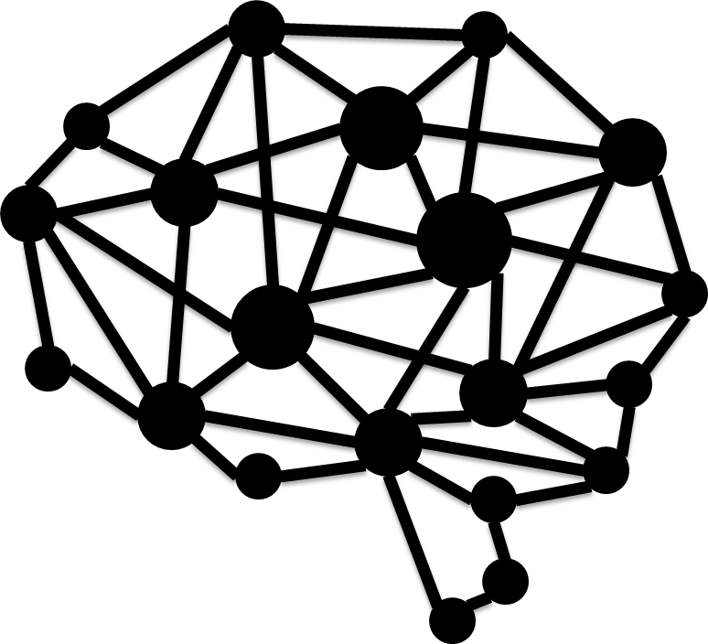




What is tinyML(Edge AI) and why do I need this?
Cloud AI
Edge AI
Benefits:
Privacy
Energy saving
Low latency
Less communication

Slide 4
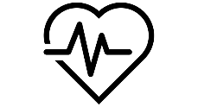
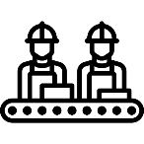
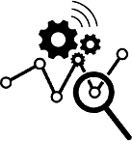
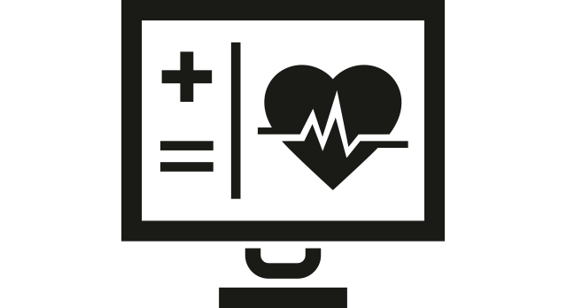
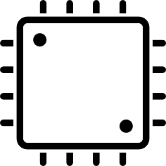
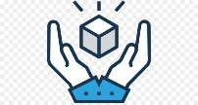

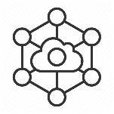

Fields of application
Mobile applications
e.g. pacemaker
Production
Predictive
Maintenance
Medical Technology
End products
Robotic
IOT
Mechanical Engineering

Slide 5
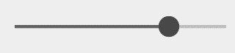
Compress neural networks
The problems get complexer
The models get bigger
Solution: to compress the model
Problem of compression: we get a trade-off
Compression rate
Accuracy

Slide 6
Quantization
Quantization is the process of constraining an input from a continuous or otherwise large set of values (such as the real numbers) to a discrete set (such as the integers).*
*Wikipedia
Notes:
https://arxiv.org/pdf/1808.04752.pdf
4x4 gewichts matrix als bsp nennen

Slide 7
Quantization
Double
Float
Fixedpoint
Integer
Binary
64x smaller
2,09 | -0,98 | 1,02 | 0,09
0,05 | -0,14 | -1,08 | 2,12
-0,91 | 1,92 | 0 | -1,03
1,87 | 0 | 1,03 | 0,98
2,09 | -2,12 | 1,92 | 1,87
0,05 | -0,14 | 0 | 0,09
-0,91 | -0,98 | -1,08 | -1,03
1,02 | 1,03 | 0,98
2
0
-1
1
Retrain
Notes:
https://arxiv.org/pdf/1808.04752.pdf
4x4 gewichts matrix als bsp nennen

Slide 8
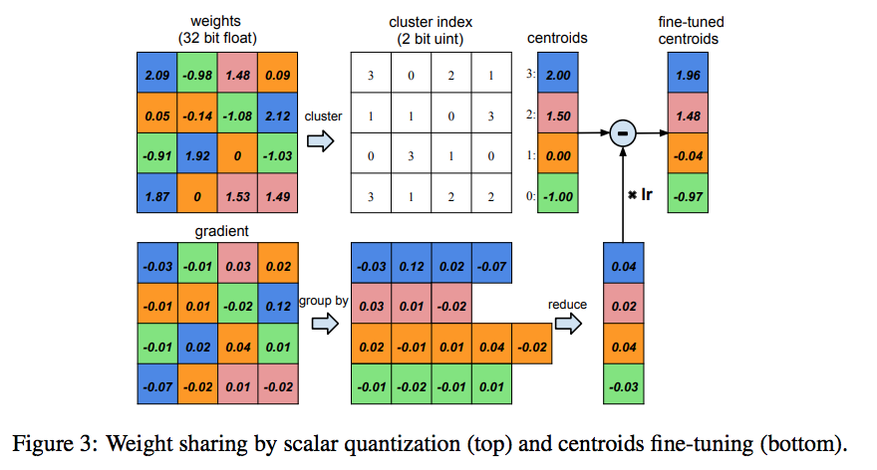
Huffman coding
Special case of quantization
Make the model smaller but increase the inference time
Can be good for Hardware implementations

Slide 9
Quantization
Pros:
Quantization can be applied both during and after training
Can be applied on all layer types
Can improve the inference time/ model size vs accuracy tradeoff for a given architecture
Cons:
Quantized weights make neural networks harder to converge. A smaller learning rate is needed to ensure the network to have good performance.
Quantized weights make back-propagation infeasible since gradient cannot back-propagate through discrete neurons. Approximation methods are needed to estimate the gradients of the loss function with respect to the input of the discrete neurons.
Notes:
https://arxiv.org/pdf/1808.04752.pdf
4x4 gewichts matrix als bsp nennen

Slide 10
Dive deeper?
https://arxiv.org/pdf/1808.04752.pdf
https://www.tensorflow.org/lite/performance/post_training_integer_quant
https://github.com/google/qkeras

Slide 11
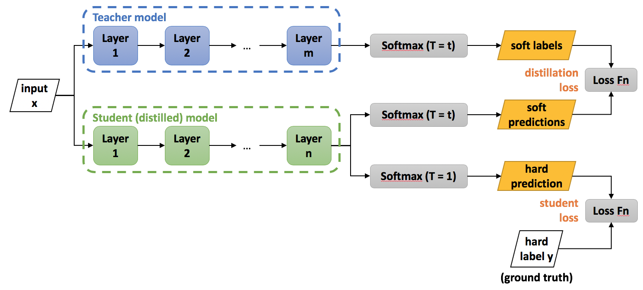
Knowledge distillation
Notes:
In knowledge distillation, a large, complex model is trained on a large dataset. When this large model can generalize and perform well on unseen data, it is transferred to a smaller network. The larger model is also known as the teacher model and the smaller network is also known as the student network.
The transferring of the generalization ability of the cumbersome model to a small model can be done by the use of class probabilities produced by the cumbersome model as “soft targets” for training the small model. For this transfer stage, we use the same training set or a separate “transfer” set as used for training the cumbersome model. When the cumbersome model is a large ensemble of simpler models, we can use arithmetic or geometric mean of their individual predictive distributions as the soft targets. When the soft targets have high entropy, they provide much more information per training case than hard targets and much less variance in the gradient between training cases, so the small model can often be trained on much less data than the original cumbersome model while using a much higher learning rate.

Slide 12
Knowledge distillation
The teacher network guides the student network
Up to 20x smaller networks
Teacher Convergence Area
Student Convergence Area
Teacher Solution Convergence
Student solution convergence with teachers
Student solution convergence without teachers
Notes:
Obviously, with more complex models, the theoretical search space in larger than that of a smaller network. However, if we assume that the same (or even similar) convergence can be achieved using a smaller network, then the convergence space of the Teacher Network should overlap with the solution space of the student network.
Unfortunately, that alone does not guarantee converge for the student network at the same location. The student network can have a convergence which might be hugely different from that of the teacher network. However, if the student network is guided to replicate the behavior of the teacher network (which has already searched through a bigger solution space), it is expected to have its convergence space overlapping with the original Teacher Network convergence space.

Slide 13
Knowledge distillation
Pros:
If you have a pre-trained teacher network, less training data required to train the smaller (student) network.
If you have a pre-trained teacher network, training of the smaller (student) network is faster.
Can downsize a network regardless of the structural difference between the teacher and the student network.
Cons:
If you do not have a pre-trained teacher network, it may require a larger dataset and take more time to train it.
A good hyper-parameter set is hard to find.
Notes:
https://arxiv.org/pdf/1808.04752.pdf
4x4 gewichts matrix als bsp nennen

Slide 14
Dive deeper?
https://arxiv.org/pdf/2006.05525.pdf
https://github.com/TropComplique/knowledge-distillation-keras

Slide 15
Pruning
Before the pruning
After the pruning
removed Synapses
removed Neurons
Notes:
Pruning reduces the number of parameters by removing redundant, unimportant connections that are not sensitive to performance. This not only helps reduce the overall model size but also saves on computation time and energy.

Slide 16
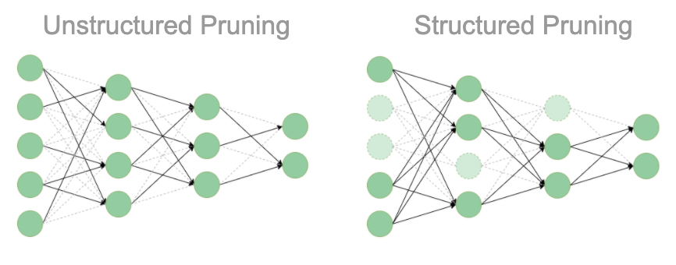
Structured pruning vs. Unstructured pruning
Unstrutured pruning: delete connections between neurons
Benefit: easy to implement
Strutured pruning: delete the whole neuron
Benefit: compress and speedup the model

Slide 17
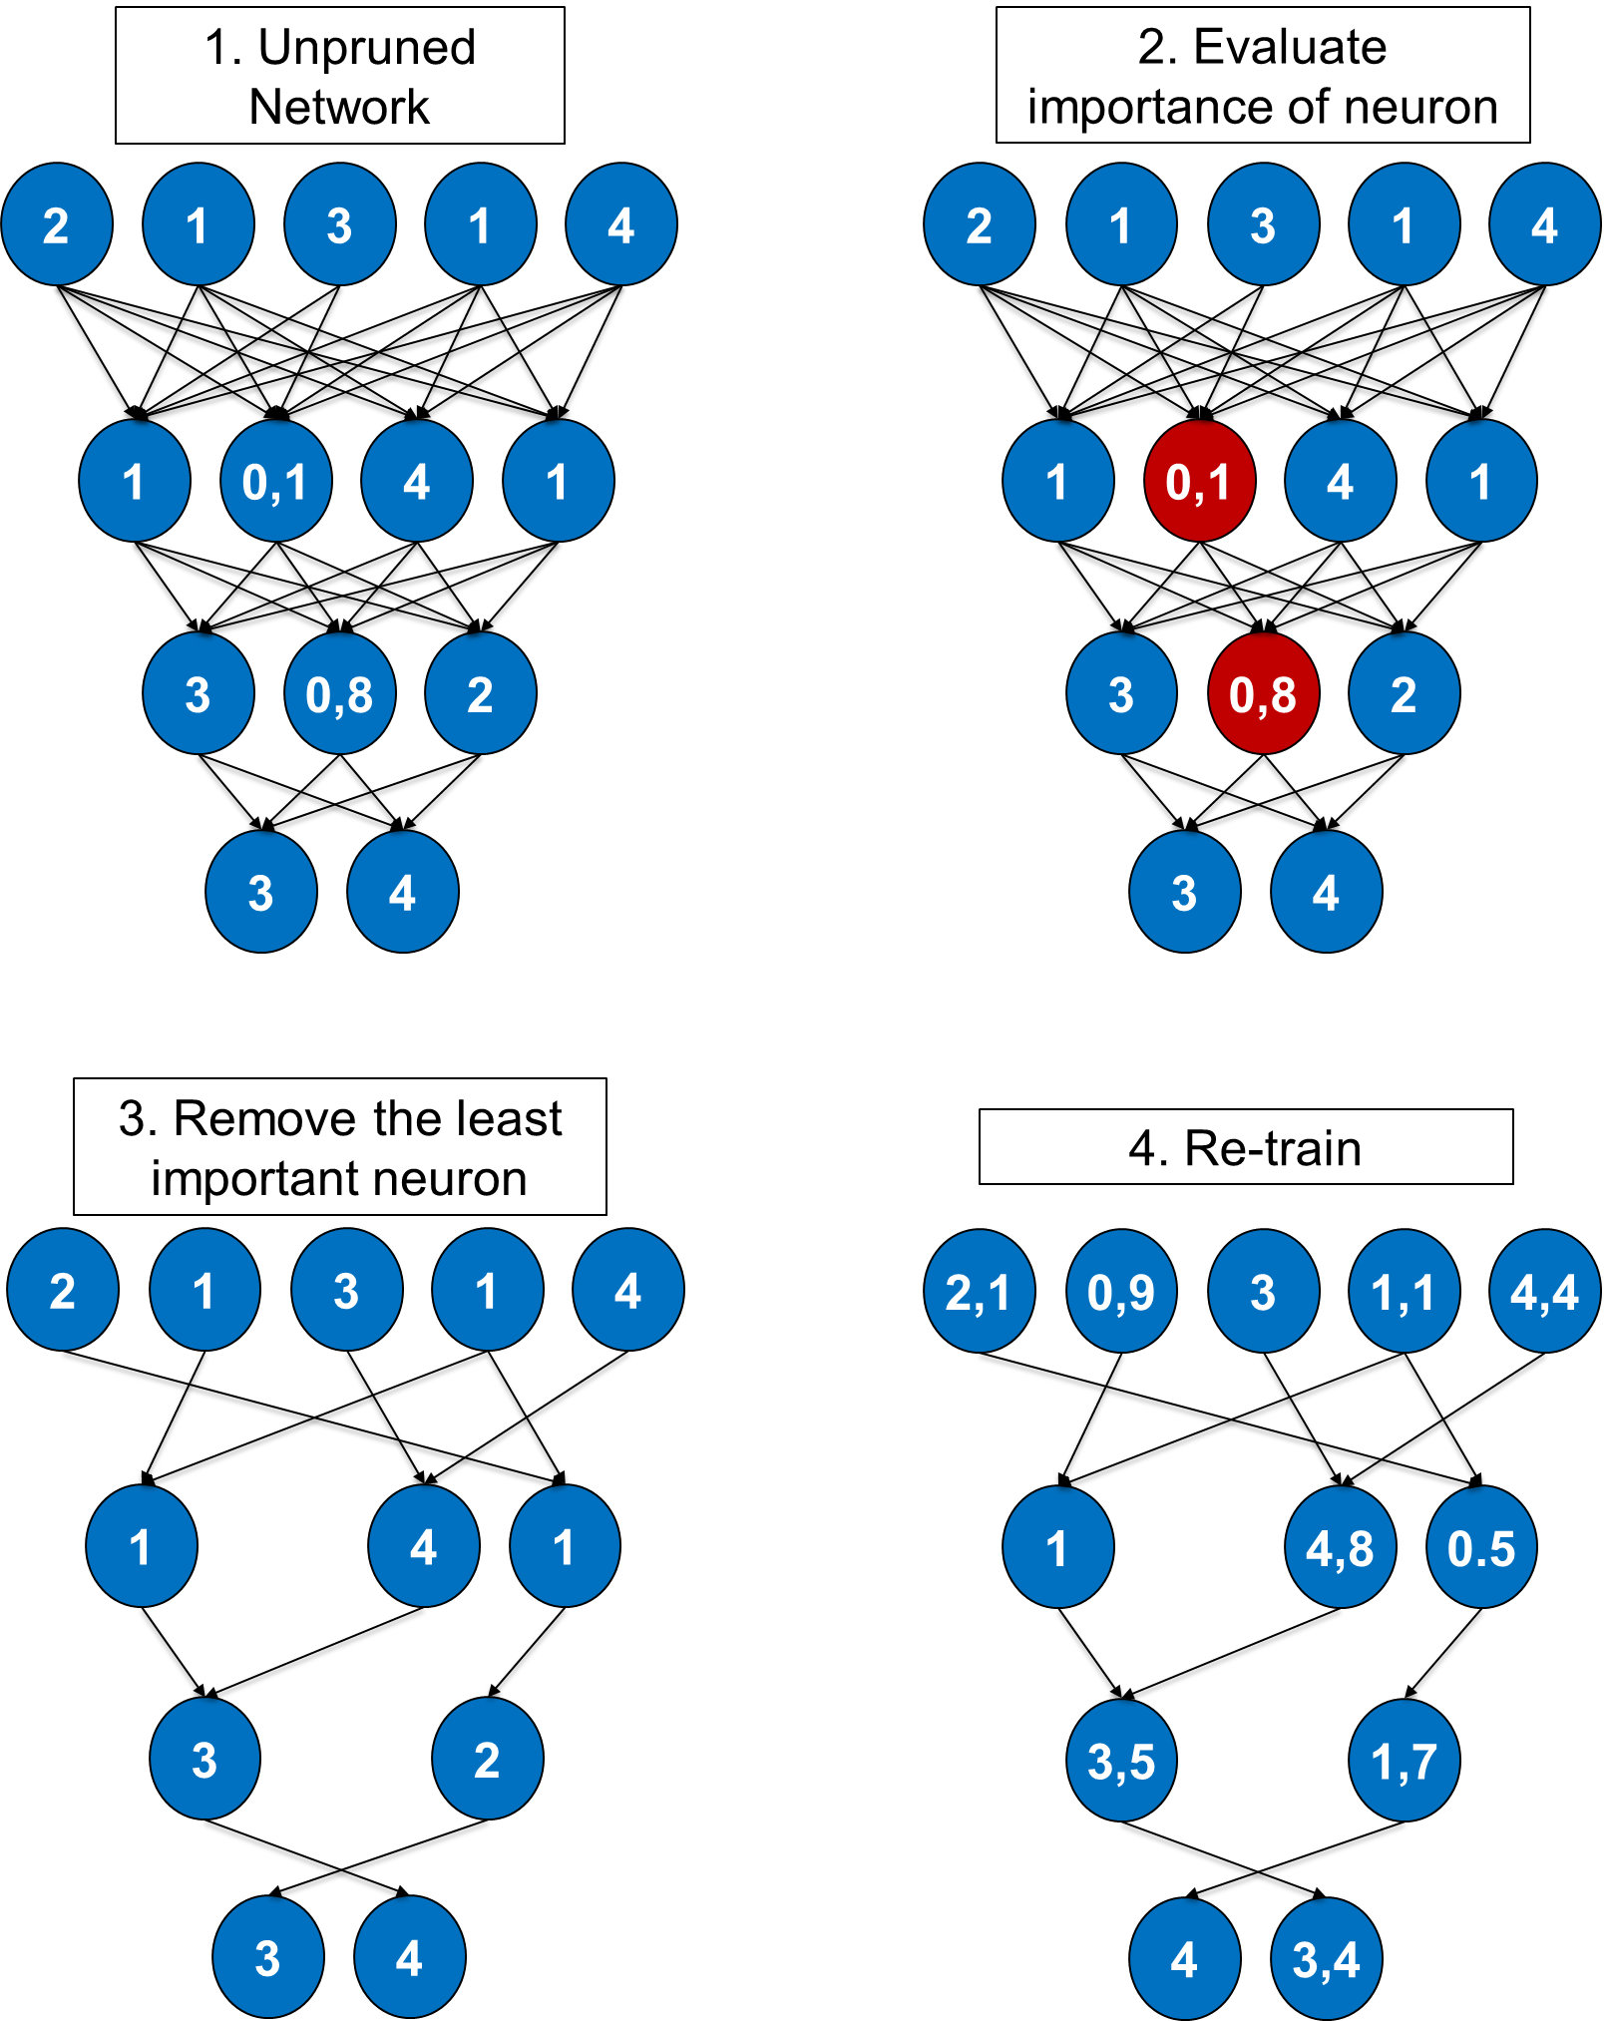
Pruning process
2 to 13x smaller

Slide 18
How to know which Conections/neurons to prune?
L1/L2 mean
Magnitude
Mean activations
The number of times a neuron was zero on some validation set
Matrix similarity

Slide 19
Pros and Cons
Pros:
Can be applied during or after training
Can improve the inference time/ model size vs accuracy tradeoff for a given architecture
Can be applied to both convolutional and fully connected layers
Better generalization
Privacy preserving networks
Cons:
Unstructured pruning does not speed up the inference

Slide 20
Dive deeper?
https://arxiv.org/pdf/1808.04752.pdf
https://www.tensorflow.org/lite/performance/post_training_integer_quant
https://github.com/Hahn-Schickard/Automatic-Structured-Pruning

Slide 21
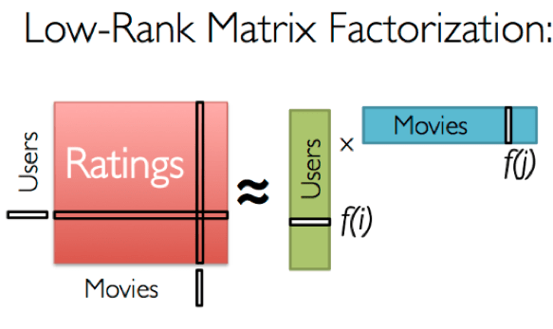
Low-rank factorization
Done by an SVD
Singular Value Decomposition (SVD) of a matrix is a factorization of that matrix into three matrices
The weight matrix get split into two vectors
Con: Decomposition is a computationally expensive task
Notes:
The key idea behind low-rank matrix factorization is that there exists latent structures in the data, by uncovering which we can obtain a compressed representation of the data. LRMF factorizes the original matrix into lower rank matrices while preserving latent structures and addressing the issue of sparseness.
Convolution operations are usually very computationally intensive in deep CNNs. Thus, reducing the number of convolution operations would help us compress the network as well as increase overall speedup.
LRMF works on the assumption that 4-D Convolution kernel tensors are highly redundant and can be decomposed to reduce this redundancy. The fully connected layers can be viewed as 2-D tensors.
LRMF methods have been around for quite some time now but they pose severe limitations since Decomposition of tensors is usually a computationally expensive task. Moreover, current state of the art methods in LRMF implement layer-by-layer low-rank approximation and thus cannot perform global parameter compression, which is important as different layers hold different information.

Slide 22
Fast-Conv
Instead of calculate the convolution, calculate transform the input into the frequency-domain and calculate a multiplication
The Filter kernel are pre-transformed
Special case: Winograd-convolution -> faster, but only with even number of filterkernelsize
Good for hardware implementations
Input i[n]
FFT
I[k]
X
O[k]
FFT⁻¹
Output o[n]
Filterkernel f[n]
FFT
F[k]

Slide 23

Selective attention network
„Divide et impera“ - divide and conquer
Two algorithm:
The first select the area of interest
The other is the neural network

Slide 24
Summary
We learned three compression methods
Quantization
Huffman coding
Knowledge distillation
Pruning
Low-rank factorization
Fast-Conv
Selective attention network
Network compression work
We can compress the model up to 20x of the size

